Slide 1
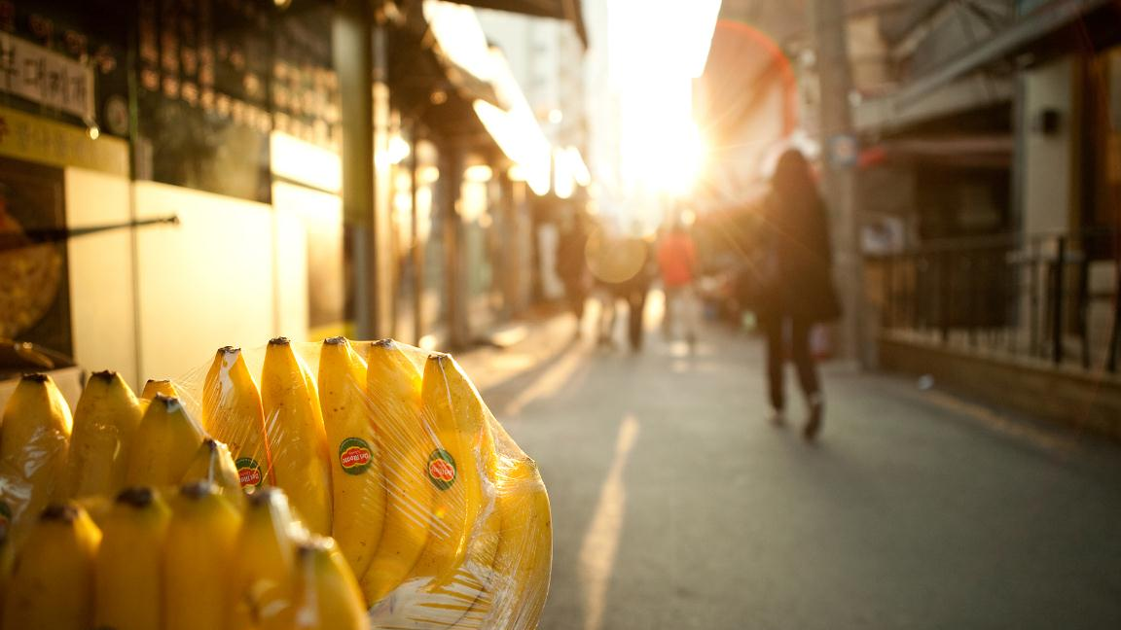
Classification is a task that requires venturing into Machine Learning rather than hard coding techniques like Template Matching.
We have to choose between Traditional ML and Deep Learning

Slide 2
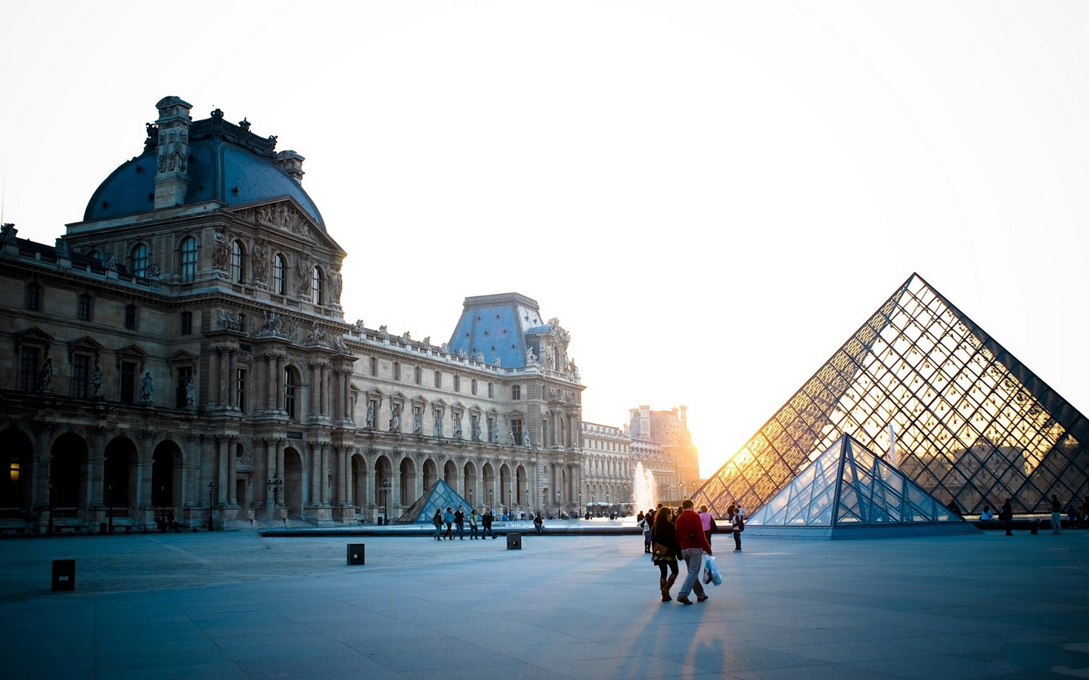
I choose Traditional ML
Given the size of the data, it is better to take the hand engineering route rather than rely on a deep neural network to learn the best features.
I went with using SVM classifier fed with images that were resized, augmented, normalized, grayscaled, and convovled through Canny Edge detection filter.
Generally, Deep Learning outperfrom traditional ML through more data, compute and better algorithms.
Alternative approach could have been using transfer learning and repurposing deeper models by modifying some layers and retraining in the last layers.

Slide 3


Conclusion
01
5 fold cross validated
Average results: 74% test set
Best result: 100% test set Mode result: 71% test set
02
Unsuccessful approaches
Padding. Sobel and laplacian filters. Connected copmonents labelling 63%. 2 layer NN with softmax 71%
03
Future endeavours
Collect more data, best bet.
The LeNet 5 CNN is relatively small and should produce good results for classification.
Notes:
https://github.com/MubashirullahD/road-sign-dataset

